Slide 1
HW9 - Prediction Challenge 1
Akshaj Kammari

Slide 2
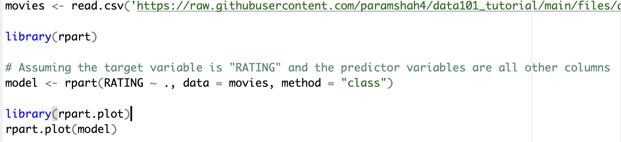
Read Training Data and Build Decision Tree Model
Reads the training data from a CSV file.
Uses the rpart library to build a decision tree model (rpart) for predicting the "RATING" variable based on all other variables in the dataset.
Visualizes the decision tree using rpart.plot.

Slide 3
Predict on Test Data
Reads the test data from a CSV file.
Uses the trained decision tree model to predict the "RATING" variable for the test data.

Slide 4
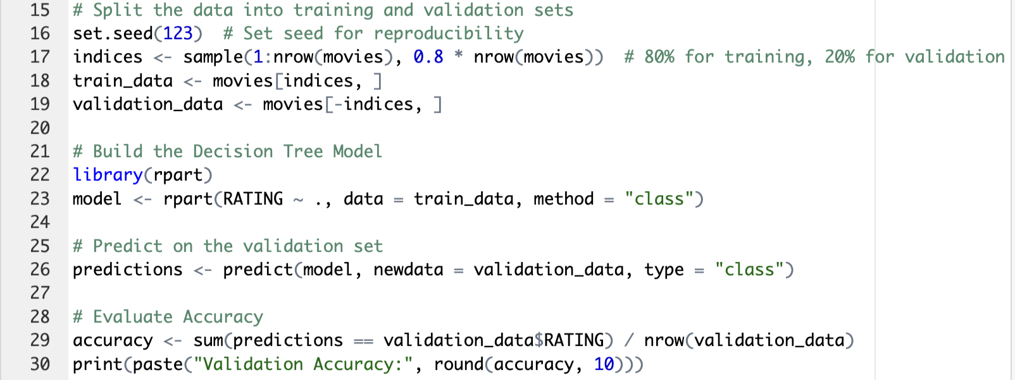
Evaluate Model on Validation Set
Splits the training data into a training set (80%) and a testing set (20%).
Builds a new decision tree model using the training set.
Evaluates the accuracy of the model on the validation set and prints the result.

Slide 5
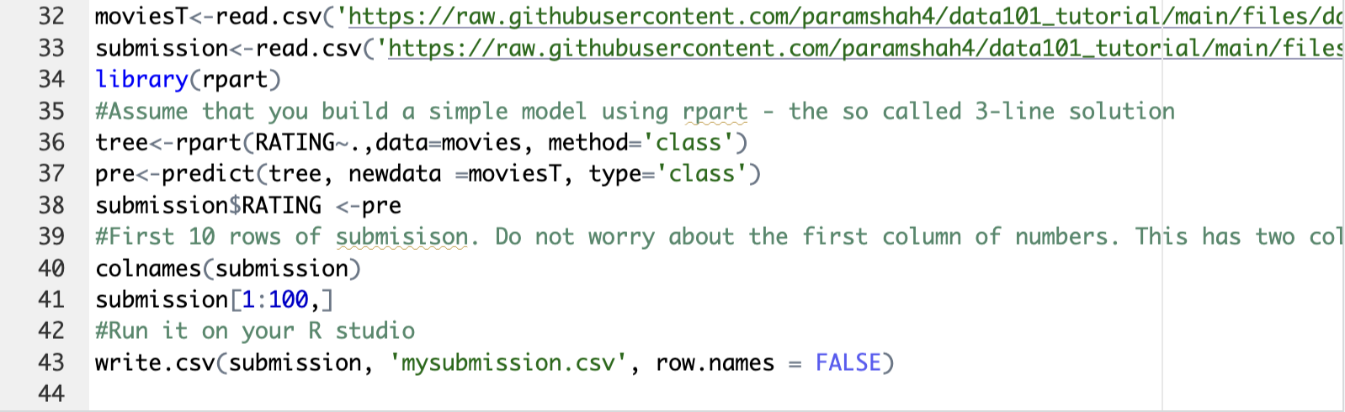
Make Submission File
Reads the test data and the submission file.
Builds a decision tree model using the entire training dataset.
Makes predictions on the test data using the trained model.
Updates the "RATING" column in the submission file with the predicted values.
Writes the submission file to a CSV named "mysubmission.csv".

